Slide 1
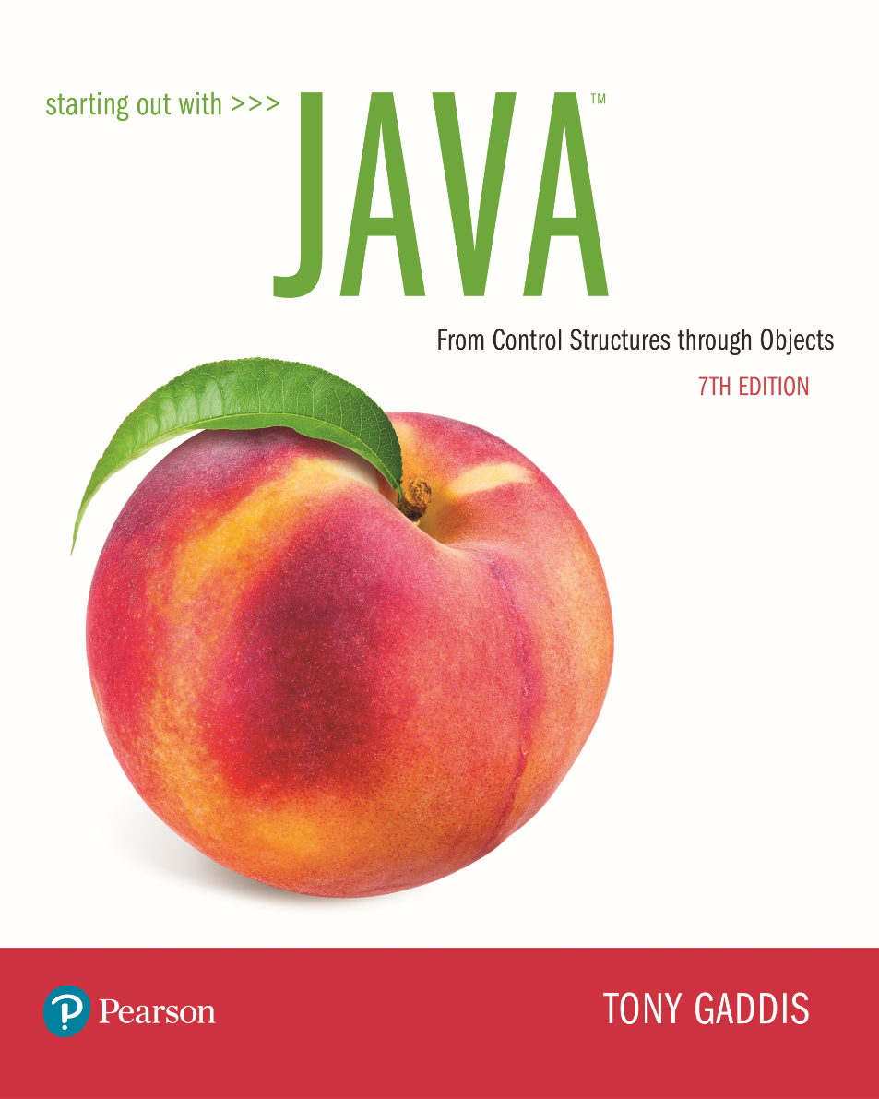
STARTING OUT WITH JAVATM
7th Edition
Chapter 2
Java Fundamentals

Slide 2
Chapter Topics (1 of 2)
Chapter 2 discusses the following main topics:
  The Parts of a Java Program
  The print and println Methods, and the Java API
  Variables and Literals
  Primitive Data Types
  Arithmetic Operators
  Combined Assignment Operators

Slide 3
Chapter Topics (2 of 2)
  Creating named constants with final
  The String class
  Scope
  Comments
  Programming style
  Using the Scanner class for input
  Dialog boxes

Slide 4
Parts of a Java Program (1 of 2)
A Java source code file contains one or more Java classes.
If more than one class is in a source code file, only one of them may be public.
The public class and the filename of the source code file must match.
    ex: A class named Simple must be in a file named Simple.java
Each Java class can be separated into parts.

Slide 5
Parts of a Java Program (2 of 2)
See example: Simple.java
To compile the example:
  javac Simple.java
    Notice the .java file extension is needed.
    This will result in a file named Simple.class being created.
To run the example:
  java Simple
    Notice there is no file extension here.
    The java command assumes the extension is .class.

Slide 6
Analyzing The Example (1 of 3)
// This is a simple Java program.
This is a Java comment. It is ignored by the compiler.
public class Simple
{
}
This is the class header
for the class Simple
This area is the body of the class Simple.
All of the data and methods for this class
will be between these curly braces.

Slide 7
Analyzing The Example (2 of 3)
This is the method header
for the main method. The
main method is where a Java
application begins.
// This is a simple Java program.
public class Simple
{
}
public static void main(String [] args)
{
}
This area is the body of the main method.
All of the actions to be completed during
the main method will be between these curly braces.

Slide 8
Analyzing The Example (3 of 3)
// This is a simple Java program.
public class Simple
{
}
public static void main(String [] args)
{
System.out.println("Programming is great fun!");
}
This is the Java Statement that
is executed when the program runs.

Slide 9
Parts of a Java Program (1 of 2)
Comments
  The line is ignored by the compiler.
  The comment in the example is a single-line comment.
Class Header
  The class header tells the compiler things about the class such as what other classes can use it (public) and that it is a Java class (class), and the name of that class (Simple).
Curly Braces
  When associated with the class header, they define the scope of the class.
  When associated with a method, they define the scope of the method.

Slide 10
Parts of a Java Program (2 of 2)
The main Method
  This line must be exactly as shown in the example (except the args variable name can be programmer defined).
  This is the line of code that the java command will run first.
  This method starts the Java program.
  Every Java application must have a main method.
Java Statements
  When the program runs, the statements within the main method will be executed.
  Can you see what the line in the example will do?

Slide 11
Java Statements (1 of 2)
If we look back at the previous example, we can see that there is only one line that ends with a semi-colon.
  System.out.println("Programming is great fun!");
This is because it is the only Java statement in the program.
The rest of the code is either a comment or other Java framework code.

Slide 12
Java Statements (2 of 2)
Comments are ignored by the Java compiler so they need no semi-colons.
Other Java code elements that do not need semi colons include:
  class headers
    Terminated by the code within its curly braces.
  method headers
    Terminated by the code within its curly braces.
  curly braces
    Part of framework code that needs no semi-colon termination.

Slide 13
Short Review (1 of 2)
Java is a case-sensitive language.
All Java programs must be stored in a file with a .java file extension.
Comments are ignored by the compiler.
A .java file may contain many classes but may only have one public class.
If a .java file has a public class, the class must have the same name as the file.

Slide 14
Short Review (2 of 2)
Java applications must have a main method.
For every left brace, or opening brace, there must be a corresponding right brace, or closing brace.
Statements are terminated with semicolons.
  Comments, class headers, method headers, and braces are not considered Java statements.

Slide 15
Special Characters
// | double slash | Marks the beginning of a single line comment.
( ) | open and close parenthesis | Used in a method header to mark the parameter list.
{ } | open and close curly braces | Encloses a group of statements, such as the contents of a class or a method.
“ ” | quotation marks | Encloses a string of characters, such as a message that is to be printed on the screen
; | semi-colon | Marks the end of a complete programming statement

Slide 16
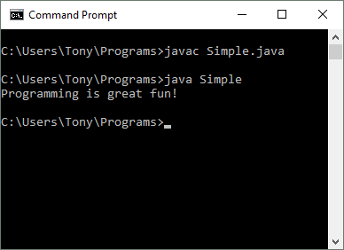
Console Output (1 of 8)
Many of the programs that you will write will run in a console window.

Slide 17
Console Output (2 of 8)
The console window that starts a Java application is typically known as the standard output device.
The standard input device is typically the keyboard.
Java sends information to the standard output device by using a Java class stored in the standard Java library.

Slide 18
Console Output (3 of 8)
Java classes in the standard Java library are accessed using the Java Applications Programming Interface (API).
The standard Java library is commonly referred to as the Java API.

Slide 19
Console Output (4 of 8)
The previous example uses the line:
  System.out.println("Programming is
  great fun!");
This line uses the System class from the standard Java library.
The System class contains methods and objects that perform system level tasks.
The out object, a member of the System class, contains the methods print and println.

Slide 20
Console Output (5 of 8)
The print and println methods actually perform the task of sending characters to the output device.
The line:
  System.out.println("Programming is great fun!");
  is pronounced: System dot out dot println …
The value inside the parenthesis will be sent to the output device (in this case, a string).

Slide 21
Console Output (6 of 8)
The println method places a newline character at the end of whatever is being printed out.
The following lines:
    System.out.println("This is being printed out");
    System.out.println("on two separate lines.");
  Would be printed out on separate lines since the first statement sends a newline command to the screen.

Slide 22
Console Output (7 of 8)
The print statement works very similarly to the println statement.
However, the print statement does not put a newline character at the end of the output.
The lines:
    System.out.print("These lines will be");
    System.out.print("printed on");
    System.out.println("the same line.");
  Will output:
  These lines will beprinted onthe same line.
  Notice the odd spacing? Why are some words run together?

Slide 23
Console Output (8 of 8)
For all of the previous examples, we have been printing out strings of characters.
Later, we will see that much more can be printed.
There are some special characters that can be put into the output.
System.out.print("This line will have a newline at the end.\n");
The \n in the string is an escape sequence that represents the newline character.
Escape sequences allow the programmer to print characters that otherwise would be unprintable.

Slide 24
Java Escape Sequences (1 of 2)
\n | newline | Advances the cursor to the next line for subsequent printing
\t | tab | Causes the cursor to skip over to the next tab stop
\b | backspace | Causes the cursor to back up, or move left, one position
\r | carriage return | Causes the cursor to go to the beginning of the current line, not the next line
\\ | backslash | Causes a backslash to be printed
\’ | single quote | Causes a single quotation mark to be printed
\” | double quote | Causes a double quotation mark to be printed

Slide 25
Java Escape Sequences (2 of 2)
Even though the escape sequences are comprised of two characters, they are treated by the compiler as a single character.
    System.out.print("These are our top sellers:\n");
    System.out.print("\tComputer games\n\tCoffee\n ");
    System.out.println("\tAspirin");
Would result in the following output:
These are our top seller:
Computer games
Coffee
Asprin
With these escape sequences, complex text output can be achieved.

Slide 26
Variables and Literals (1 of 2)
A variable is a named storage location in the computer’s memory.
A literal is a value that is written into the code of a program.
Programmers determine the number and type of variables a program will need.
See example:Variable.java

Slide 27
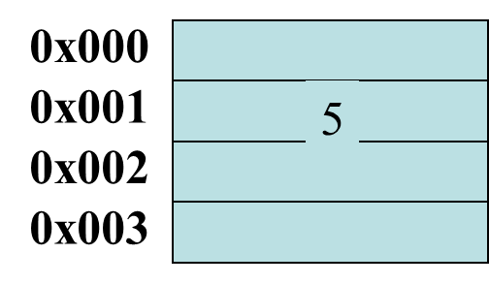
Variables and Literals (2 of 2)
This line is called
a variable declaration.
int value;
The following line is known
as an assignment statement.
value = 5;
The value 5
is stored in
memory.
This is a string literal. It will be printed as is.
System.out.print("The value is ");
System.out.println(value);
The integer 5 will
be printed out here.
Notice no quote marks?

Slide 28
The + Operator
The + operator can be used in two ways.
  as a concatenation operator
  as an addition operator
If either side of the + operator is a string, the result will be a string.
  System.out.println("Hello " + "World");
  System.out.println("The value is: " + 5);
  System.out.println("The value is: " + value);
  System.out.println("The value is: " + ‘/n’ + 5);

Slide 29
String Concatenation (1 of 3)
Java commands that have string literals must be treated with care.
A string literal value cannot span lines in a Java source code file.
  System.out.println("This line is too long and now it has spanned more than one line, which will cause a syntax error to be generated by the compiler. ");

Slide 30
String Concatenation (2 of 3)
The String concatenation operator can be used to fix this problem.
    System.out.println("These lines are " +
    "are now ok and will not " +
    "cause the error as before.");
String concatenation can join various data types.
    System.out.println("We can join a string to " +
    "a number like this: " + 5);

Slide 31
String Concatenation (3 of 3)
The Concatenation operator can be used to format complex String objects.
    System.out.println("The following will be printed " +
    "in a tabbed format: " +
    \n\tFirst = " + 5 * 6 + ", " +
    "\n\tSecond = " (6 + 4) + "," +
    "\n\tThird = " + 16.7 + ".");
Notice that if an addition operation is also needed, it must be put in parenthesis.

Slide 32
Identifiers (1 of 2)
Identifiers are programmer-defined names for:
  classes
  variables
  methods
Identifiers may not be any of the Java reserved keywords.

Slide 33
Identifiers (2 of 2)
Identifiers must follow certain rules:
  An identifier may only contain:
    letters a–z or A–Z,
    the digits 0–9,
    underscores (_), or
    the dollar sign ($)
  The first character may not be a digit.
  Identifiers are case sensitive.
    itemsOrdered is not the same as itemsordered.
  Identifiers cannot include spaces.

Slide 34
Java Reserved Keywords
abstract
assert
boolean
break
byte
case
catch
char
class
const
continue
default
do
double
else
enum
extends
false
for
final
finally
float
goto
if
implements
import
instanceof
int
interface
long
native
new
null
package
private
protected
public
return
short
static
strictfp
super
switch
synchronized
this
throw
throws
transient
true
try
void
volatile
while

Slide 35
Variable Names
Variable names should be descriptive.
Descriptive names allow the code to be more readable; therefore, the code is more maintainable.
Which of the following is more descriptive?
      double tr = 0.0725;
      double salesTaxRate = 0.0725;
Java programs should be self-documenting.

Slide 36
Java Naming Conventions
Variable names should begin with a lower case letter and then switch to title case thereafter:
    Ex: int caTaxRate
Class names should be all title case.
    Ex: public class BigLittle
More Java naming conventions can be found at:
  http://java.sun.com/docs/codeconv/html/CodeConventions.doc8.html
A general rule of thumb about naming variables and classes are that, with some exceptions, their names tend to be nouns or noun phrases.

Slide 37
Primitive Data Types
Primitive data types are built into the Java language and are not derived from classes.
There are 8 Java primitive data types.
  byte
  short
  int
  long

Slide 38
Numeric Data Types
byte | 1 byte | Integers in the range -128 to +127
short | 2 bytes | Integers in the range of -32,768 to +32,767
int | 4 bytes | Integers in the range of -2,147,483,648 to +2,147,483,647
long | 8 bytes | Integers in the range of -9,223,372,036,854,775,808 to +9,223,372,036,854,775,807
float | 4 bytes | Floating-point numbers in the range of ±3.410-38 to ±3.41038, with 7 digits of accuracy
double | 8 bytes | Floating-point numbers in the range of ±1.710-308 to ±1.710308, with 15 digits of accuracy

Slide 39
Variable Declarations
Variable Declarations take the following form:
  DataType VariableName;
    byte inches;
    short month;
    int speed;
    long timeStamp;
    float salesCommission;
    double distance;

Slide 40
Integer Data Types
byte, short, int, and long are all integer data types.
They can hold whole numbers such as 5, 10, 23, 89, etc.
Integer data types cannot hold numbers that have a decimal point in them.
Integers embedded into Java source code are called integer literals.
See Example: IntegerVariables.java

Slide 41
Floating Point Data Types
Data types that allow fractional values are called floating-point numbers.
  1.7 and -45.316 are floating-point numbers.
In Java there are two data types that can represent floating-point numbers.
  float - also called single precision (7 decimal points).
  double - also called double precision (15 decimal points).

Slide 42
Floating Point Literals (1 of 3)
When floating point numbers are embedded into Java source code they are called floating point literals.
The default type for floating point literals is double.
  29.75, 1.76, and 31.51 are double data types.
Java is a strongly-typed language.
See example: Sale.java

Slide 43
Floating Point Literals (2 of 3)
A double value is not compatible with a float variable because of its size and precision.
  float number;
  number = 23.5; // Error!
A double can be forced into a float by appending the letter F or f to the literal.
  float number;
  number = 23.5F; // This will work.

Slide 44
Floating Point Literals (3 of 3)
Literals cannot contain embedded currency symbols or commas.
  grossPay = $1,257.00; // ERROR!
  grossPay = 1257.00; // Correct.
Floating-point literals can be represented in scientific notation.
  47,281.97 == 4.728197 x 10⁴.
Java uses E notation to represent values in scientific notation.
  4.728197X10⁴ == 4.728197E4.

Slide 45
Scientific and E Notation
Decimal Notation | Scientific Notation | E Notation
247.91 | 2.4791 x 10² | 2.4791E2
0.00072 | 7.2 x 10⁻⁴ | 7.2E-4
2,900,000 | 2.9 x 10⁶ | 2.9E6
See example: SunFacts.java

Slide 46
The boolean Data Type
The Java boolean data type can have two possible values.
  true
  false
The value of a boolean variable may only be copied into a boolean variable.
See example: TrueFalse.java

Slide 47
The char Data Type
The Java char data type provides access to single characters.
char literals are enclosed in single quote marks.
  ‘a’, ‘Z’, ‘\n’, ‘1’
Don’t confuse char literals with string literals.
  char literals are enclosed in single quotes.
  String literals are enclosed in double quotes.
See example: Letters.java

Slide 48
Unicode (1 of 5)
Internally, characters are stored as numbers.
Character data in Java is stored as Unicode characters.
The Unicode character set can consist of 65536 (2¹⁶) individual characters.
This means that each character takes up 2 bytes in memory.
The first 256 characters in the Unicode character set are compatible with the ASCII* character set.
See example: Letters2.java
*American Standard Code for Information Interchange

Slide 49
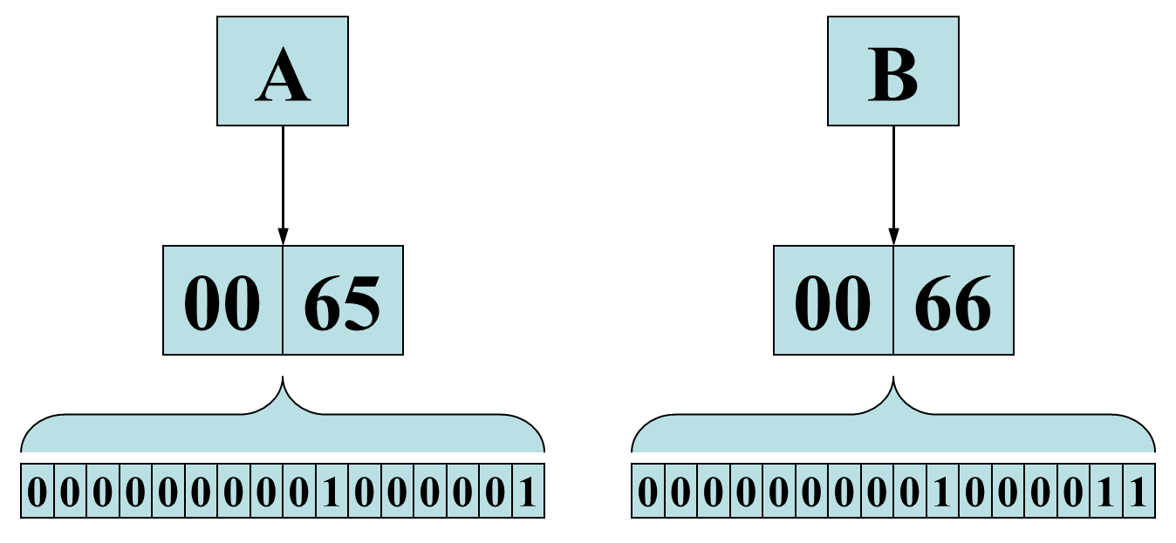
Unicode (2 of 5)

Slide 50
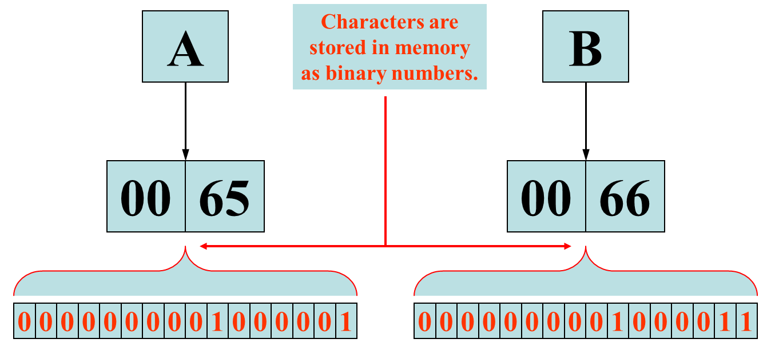
Unicode (3 of 5)

Slide 51
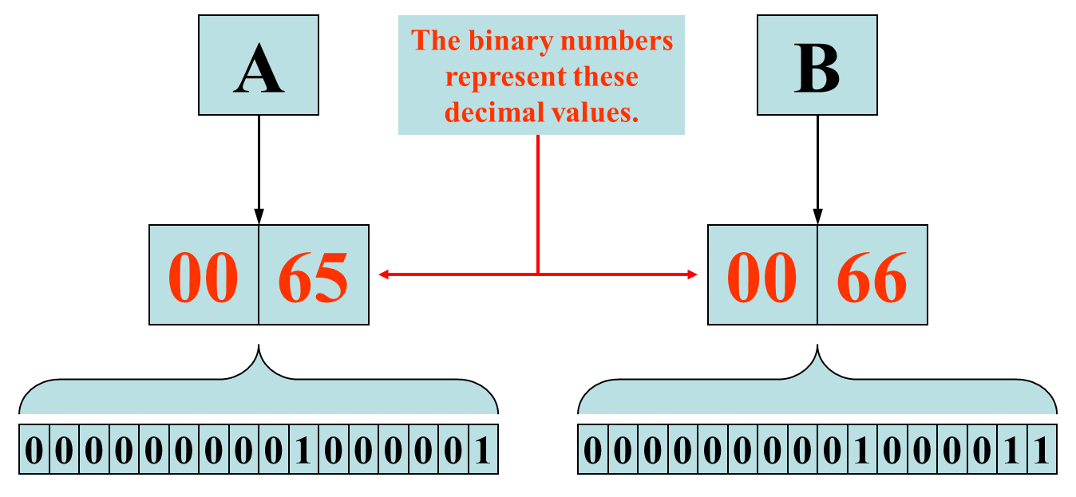
Unicode (4 of 5)

Slide 52
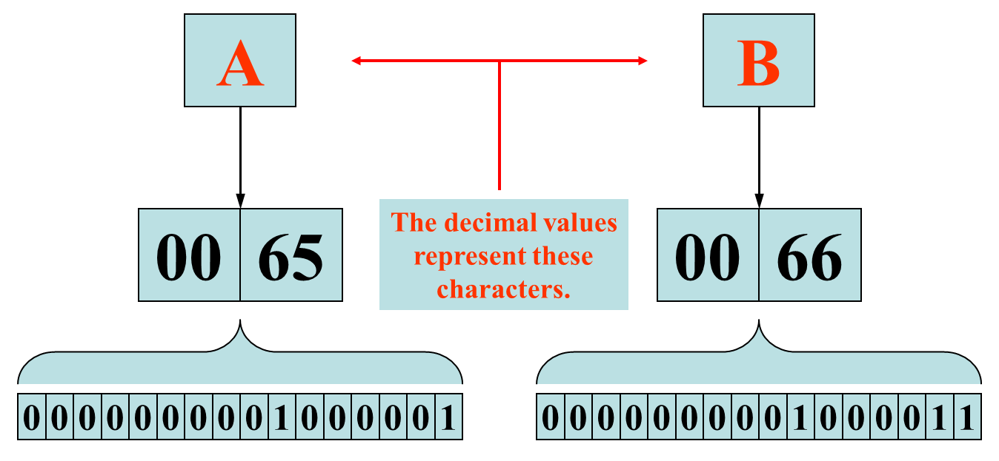
Unicode (5 of 5)

Slide 53
Variable Assignment and Initialization
(1 of 6)
In order to store a value in a variable, an assignment statement must be used.
The assignment operator is the equal (=) sign.
The operand on the left side of the assignment operator must be a variable name.
The operand on the right side must be either a literal or expression that evaluates to a type that is compatible with the type of the variable.

Slide 54
Variable Assignment and Initialization
(2 of 6)
// This program shows variable assignment.
public class Initialize
{
public static void main(String[] args)
{
int month, days;
month = 2;
days = 28;
System.out.println("Month " + month + " has " +
days + " Days.");
}
}
The variables must be declared before they can be used.

Slide 55
Variable Assignment and Initialization
(3 of 6)
// This program shows variable assignment.
public class Initialize
{
public static void main(String[] args)
{
int month, days;
month = 2;
days = 28;
System.out.println("Month " + month + " has " +
days + " Days.");
}
}
Once declared, they can then receive a value (initialization);
however the value must be compatible with the variable’s
declared type.

Slide 56
Variable Assignment and Initialization
(4 of 6)
// This program shows variable assignment.
public class Initialize
{
public static void main(String[] args)
{
int month, days;
month = 2;
days = 28;
System.out.println("Month " + month + " has " +
days + " Days.");
}
}
After receiving a value, the variables can then be used in
output statements or in other calculations.

Slide 57
Variable Assignment and Initialization
(5 of 6)
// This program shows variable initialization.
public class Initialize
{
public static void main(String[] args)
{
int month = 2, days = 28;
System.out.println("Month " + month + " has " +
days + " Days.");
}
}
Local variables can be declared and initialized on
the same line.

Slide 58
Variable Assignment and Initialization
(6 of 6)
Variables can only hold one value at a time.
Local variables do not receive a default value.
Local variables must have a valid type in order to be used.
public static void main(String [] args)
{
int month, days; //No value given…
System.out.println("Month " + month + " has " +
days + " Days.");
}
Trying to use uninitialized variables will generate a Syntax Error when the code is compiled.

Slide 59
Arithmetic Operators (1 of 2)
Java has five (5) arithmetic operators.
Operator | Meaning | Type | Example
+ | Addition | Binary | total = cost + tax;
- | Subtraction | Binary | cost = total – tax;
* | Multiplication | Binary | tax = cost * rate;
/ | Division | Binary | salePrice = original / 2;
% | Modulus | Binary | remainder = value % 5;

Slide 60
Arithmetic Operators (2 of 6)
The operators are called binary operators because they must have two operands.
Each operator must have a left and right operator.
See example: Wages.java
The arithmetic operators work as one would expect.
It is an error to try to divide any number by zero.
When working with two integer operands, the division operator requires special attention.

Slide 61
Integer Division
Division can be tricky.
  In a Java program, what is the value of 1/2?
You might think the answer is 0.5…
But, that’s wrong.
The answer is simply 0.
Integer division will truncate any decimal remainder.

Slide 62
Operator Precedence
Mathematical expressions can be very complex.
There is a set order in which arithmetic operations will be carried out.
Operator | Associativity | Example | Result
- (unary negation) | Right to left | x = -4 + 3; | -1
* / % | Left to right | x = -4 + 4 % 3 * 13 + 2; | 11
+ - | Left to right | x = 6 + 3 – 4 + 6 * 3; | 23
Higher
Priority
Lower
Priority

Slide 63
Grouping with Parenthesis
When parenthesis are used in an expression, the inner most parenthesis are processed first.
If two sets of parenthesis are at the same level, they are processed left to right.
x = ((4*5) / (5-2) ) – 25; // result = -19
3
1
2
4

Slide 64
Combined Assignment Operators (1 of 2)
Java has some combined assignment operators.
These operators allow the programmer to perform an arithmetic operation and assignment with a single operator.
Although not required, these operators are popular since they shorten simple equations.

Slide 65
Combined Assignment Operators (2 of 2)
Operator | Example | Equivalent | Value of variable after operation
+= | x += 5; | x = x + 5; | The old value of x plus 5.
-= | y -= 2; | y = y – 2; | The old value of y minus 2
*= | z *= 10; | z = z * 10; | The old value of z times 10
/= | a /= b; | a = a / b; | The old value of a divided by b.
%= | c %= 3; | c = c % 3; | The remainder of the division of the old value of c divided by 3.

Slide 66
Creating Constants with final (1 of 3)
Many programs have data that does not need to be changed.
Littering programs with literal values can make the program hard do read and maintain.
Replacing literal values with constants remedies this problem.
Constants allow the programmer to use a name rather than a value throughout the program.
Constants also give a singular point for changing those values when needed.

Slide 67
Creating Constants with final (2 of 3)
Constants keep the program organized and easier to maintain.
Constants are identifiers that can hold only a single value.
Constants are declared using the keyword final.
Constants need not be initialized when declared; however, they must be initialized before they are used or a compiler error will be generated.

Slide 68
Creating Constants with final (3 of 3)
Once initialized with a value, constants cannot be changed programmatically.
By convention, constants are all upper case and words are separated by the underscore character.
  final int CAL_SALES_TAX = 0.725;

Slide 69
The String Class
Java has no primitive data type that holds a series of characters.
The String class from the Java standard library is used for this purpose.
In order to be useful, the a variable must be created to reference a String object.
  String number;
Notice the S in String is upper case.
By convention, class names should always begin with an upper case character.

Slide 70
Primitive vs. Reference Variables (1 of 2)
Primitive variables actually contain the value that they have been assigned.
  number = 25;
The value 25 will be stored in the memory location associated with the variable number.
Objects are not stored in variables, however. Objects are referenced by variables.

Slide 71
Primitive vs. Reference Variables (2 of 2)
When a variable references an object, it contains the memory address of the object’s location.
Then it is said that the variable references the object.
  String cityName = "Charleston";
The object that contains the
character string “Charleston”
Charleston
cityName
Address to the object

Slide 72
String Objects
A variable can be assigned a String literal.
  String value = "Hello";
Strings are the only objects that can be created in this way.
A variable can be created using the new keyword.
  String value = new String("Hello");
This is the method that all other objects must use when they are created.
See example: StringDemo.java

Slide 73
The String Methods
Since String is a class, objects that are instances of it have methods.
One of those methods is the length method.
  stringSize = value.length();
This statement runs the length method on the object pointed to by the value variable.
See example: StringLength.java

Slide 74
String Methods
The String class contains many methods that help with the manipulation of String objects.
String objects are immutable, meaning that they cannot be changed.
Many of the methods of a String object can create new versions of the object.
See example: StringMethods.java

Slide 75
Scope
Scope refers to the part of a program that has access to a variable’s contents.
Variables declared inside a method (like the main method) are called local variables.
Local variables’ scope begins at the declaration of the variable and ends at the end of the method in which it was declared.
See example: Scope.java (This program contains an intentional error.)

Slide 76
Commenting Code (1 of 3)
Java provides three methods for commenting code.
Comment Style | Description
// | Single line comment. Anything after the // on the line will be ignored by the compiler.
/* … */ | Block comment. Everything beginning with /* and ending with the first */ will be ignored by the compiler. This comment type cannot be nested.
/** … */ | Javadoc comment. This is a special version of the previous block comment that allows comments to be documented by the javadoc utility program. Everything beginning with the /** and ending with the first */ will be ignored by the compiler. This comment type cannot be nested.

Slide 77
Commenting Code (2 of 3)
Javadoc comments can be built into HTML documentation.
See example: Comment3.java
To create the documentation:
  Run the javadoc program with the source file as an argument
  Ex: javadoc Comment3.java
The javadoc program will create index.html and several other documentation files in the same directory as the input file.

Slide 78
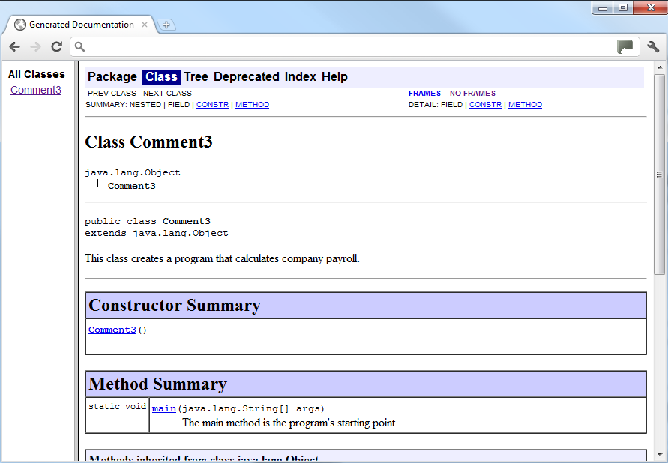
Commenting Code (3 of 3)
Example index.html:

Slide 79
Programming Style
Although Java has a strict syntax, whitespace characters are ignored by the compiler.
The Java whitespace characters are:
  space
  tab
  newline
  carriage return
  form feed
See example: Compact.java

Slide 80
Indentation
Programs should use proper indentation.
Each block of code should be indented a few spaces from its surrounding block.
Two to four spaces are sufficient.
Tab characters should be avoided.
  Tabs can vary in size between applications and devices.
  Most programming text editors allow the user to replace the tab with spaces.
See example: Readable.java

Slide 81
The Scanner Class (1 of 2)
To read input from the keyboard we can use the Scanner class.
The Scanner class is defined in java.util, so we will use the following statement at the top of our programs:
import java.util.Scanner;

Slide 82
The Scanner Class (2 of 2)
Scanner objects work with System.in
To create a Scanner object:
Scanner keyboard = new Scanner (System.in);
Scanner class methods are listed in Table 2-18 in the text.
See example: Payroll.java

Slide 83
Dialog Boxes
A dialog box is a small graphical window that displays a message to the user or requests input.
A variety of dialog boxes can be displayed using the JOptionPane class.
Two of the dialog boxes are:
  Message Dialog - a dialog box that displays a message.
  Input Dialog - a dialog box that prompts the user for input.

Slide 84
The JOptionPane Class (1 of 2)
The JOptionPane class is not automatically available to your Java programs.
The following statement must be before the program’s class header:
  import javax.swing.JOptionPane;
This statement tells the compiler where to find the JOptionPane class.

Slide 85
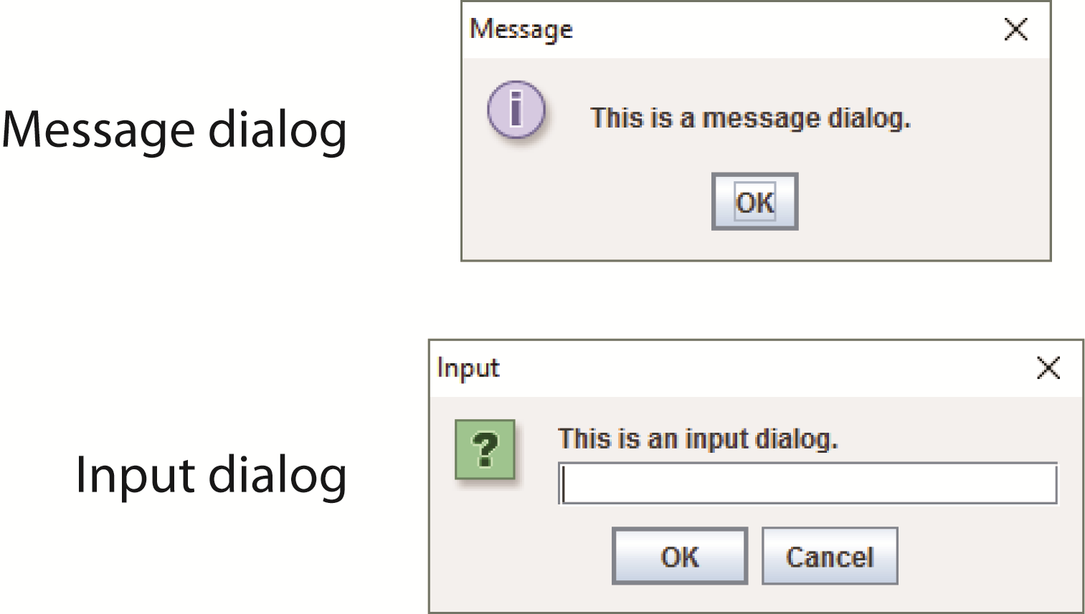
The JOptionPane Class (2 of 2)
The JOptionPane class provides methods to display each type of dialog box.

Slide 86
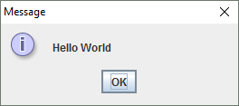
Message Dialogs
JOptionPane.showMessageDialog method is used to display a message dialog.
  JOptionPane.showMessageDialog(null, "Hello World");
The first argument will be discussed in Chapter 7.
The second argument is the message that is to be displayed.

Slide 87
Input Dialogs (1 of 2)
An input dialog is a quick and simple way to ask the user to enter data.
The dialog displays a text field, an Ok button and a Cancel button.
If Ok is pressed, the dialog returns the user’s input.
If Cancel is pressed, the dialog returns null.

Slide 88
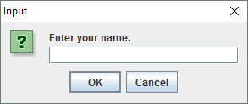
Input Dialogs (2 of 2)
  String name;
  name = JOptionPane.showInputDialog("Enter your name.");
The argument passed to the method is the message to display.
If the user clicks on the OK button, name references the string entered by the user.
If the user clicks on the Cancel button, name references null.

Slide 89
The System.exit Method (1 of 2)
A program that uses JOptionPane does not automatically stop executing when the end of the main method is reached.
Java generates a thread, which is a process running in the computer, when a JOptionPane is created.
If the System.exit method is not called, this thread continues to execute.

Slide 90
The System.exit Method (2 of 2)
The System.exit method requires an integer argument.
  System.exit(0);
This argument is an exit code that is passed back to the operating system.
This code is usually ignored, however, it can be used outside the program:
  to indicate whether the program ended successfully or as the result of a failure.
  The value 0 traditionally indicates that the program ended successfully.

Slide 91
Converting a String to a Number
The JOptionPane’s showInputDialog method always returns the user's input as a String
A String containing a number, such as “127.89, can be converted to a numeric data type.

Slide 92
The Parse Methods (1 of 2)
Each of the numeric wrapper classes, (covered in Chapter 10) has a method that converts a string to a number.
  The Integer class has a method that converts a string to an int,
  The Double class has a method that converts a string to a double, and
  etc.
These methods are known as parse methods because their names begin with the word “parse.”

Slide 93
The Parse Methods (2 of 2)
  // Store 1 in bVar.
  byte bVar = Byte.parseByte("1");
  // Store 2599 in iVar.
  int iVar = Integer.parseInt("2599");
  // Store 10 in sVar.
  short sVar = Short.parseShort("10");
  // Store 15908 in lVar.
  long lVar = Long.parseLong("15908");
  // Store 12.3 in fVar.
  float fVar = Float.parseFloat("12.3");
  // Store 7945.6 in dVar.
  double dVar = Double.parseDouble("7945.6");

Slide 94
Reading an Integer with an Input Dialog
int number;
String str;
str = JOptionPane.showInputDialog(
"Enter a number.");
number = Integer.parseInt(str);

Slide 95
Reading a double with an Input Dialog
double price;
String str;
str = JOptionPane.showInputDialog(
"Enter the retail price.");
price = Double.parseDouble(str);
See example: PayrollDialog.java

Slide 96
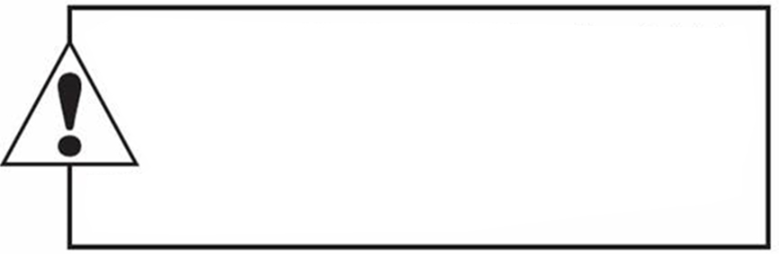
Copyright
This work is protected by United States copyright laws and is provided solely
for the use of instructions in teaching their courses and assessing student
learning. dissemination or sale of any part of this work (including on the
World Wide Web) will destroy the integrity of the work and is not permit-
ted. The work and materials from it should never be made available to
students except by instructors using the accompanying text in their
classes. All recipients of this work are expected to abide by these
restrictions and to honor the intended pedagogical purposes and the needs of
other instructors who rely on these materials.

